Slide 1

vision1
English for school
Lesson 2
Creat by: F.Kheradmand

Slide 2
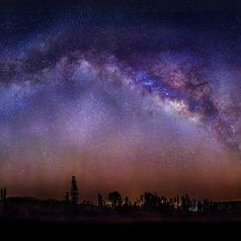
Wonders of creation
a system of millions or billions of stars, together with gas and dust, held together by gravitational attraction.
#Galaxy

Slide 3
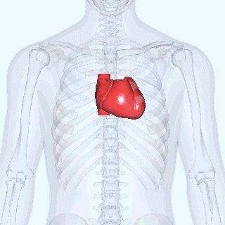
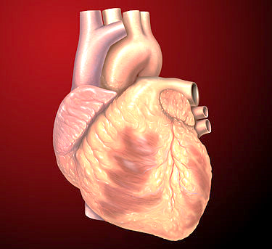
Heart & blood
The heart is a muscle in humans and other animals that circulates blood through the blood vessel in the bloodstream. Provides oxygen and nutrients for the body and also helps to eliminate waste from metabolism (metabolism).
قلب نوعی عضو عضلانی در انسان‌ها و دیگر حیوانات است که خون را از طریق رگ خونی در دستگاه گردش خون به گردش درمی‌آورد. خون اکسیژن و مواد غذایی لازم را برای بدن مهیا می‌سازد و همچنین به از بین رفتن مواد زائد ناشی از متابولیسم (سوخت و ساز بدن) کمک می‌کند.

Slide 4
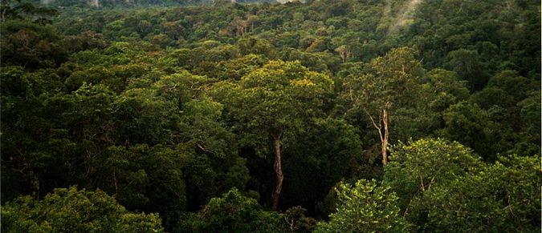
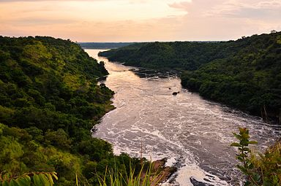
Nature
آمازون، نام بزرگ‌ترین جنگل بارانی جهان است که در شمال آمریکای جنوبی قرار گرفته و بیشتر آن در خاک برزیل و پرو جای دارد. بیش از نیمی از تمامی جنگل‌های بارانی باقی‌مانده در جهان در آمازون قرار دارد
Amazon is the name of the world's largest rain forest, located in North America, most of them in Brazil and Peru. More than half of all the world's remaining rain forests in the world are located in Amazon
Neil is the longest river in the world. This river is northeast of Africa and is considered the lifeblood of Egypt.
نیل طولانی ترین رود جهان است. این رود در شمال شرقی افریقا قرار دارد و رگ حیات کشور مصر به شمار میآید.

Slide 5
Conversation
Ms.Tabesh: Are you interested in the planets?
Alireza: Yes! They are really interesting for me, but I don’t know much about them.
Ms.Tabesh: Planets are really amazing but not so much alike. Do you know how they are different?
Alireza: Umm... I know they go around the Sun in different orbits.
Ms.Tabesh: That’s right. They have different colors and sizes, too. Some are rocky like Mars, some have rings like Saturn and some have moons like Uranus.
Alireza: How wonderful! Can we see them without a telescope?
Ms.Tabesh: Yeah..., we can see the planets nearer to us without a telescope, such as Mercury, Venus, Mars, Jupiter and Saturn. We can see Uranus and Neptune only with powerful telescopes
. Alireza: And which planet is the largest of all?
Ms.Tabesh: Jupiter is the largest one. It has more than sixty moons. Do you want to look at it?
Alireza: I really like that.

Slide 6
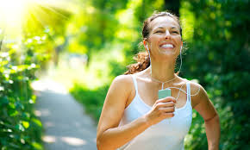
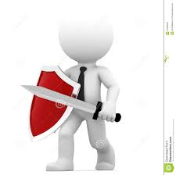
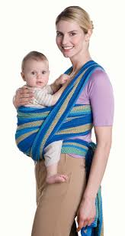
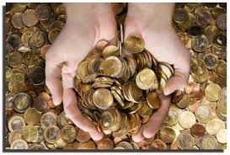
New words of book
healthy: strong and well He is a healthy boy. good for your body A healthy breakfast can give you more energy.
defend: to protect someone or something from danger The brave soldiers defended our country in war.
carry: to move someone or something from one place to another Monkeys carry their babies all day long.
collect: to go and get someone or something The school bus collects the children each morning.
fact: things that are true or that really happened It’s a fact that Earth goes around the Sun

Slide 7
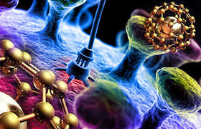
A wonder of liquid
The human body is a real wonder. It is sometimes good to think about our body and how it works. Our body is doing millions of jobs all the time.
One of the most important parts of the body is blood. The heart pumps this red liquid around the body. This keeps us healthy and alive. More than half of blood is plasma. This is a clear and yellow liquid. It carries red and white cells. There are millions of red blood cells in one small drop of blood. They carry oxygen round the body and collect carbon dioxide from body parts. There are thousands of white cells in a drop of blood. They are bigger than red cells. They defend our body against microbes.
This wonderful liquid is a great gift from Allah. We can thank Allah by keeping our body healthy. One way to do that is eating healthy food and doing daily exercises. Another way is to donate our blood to those who need it.

Slide 8

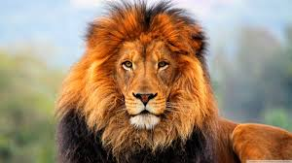
grammar
Adjectives
Look at the
I just watched an
They are
He works with
sky!
movie.
people.
computers
blue
Interesting
amazing
powerful
Many interesting animals live in forests of Iran
. Robert’s father is a very tall man

Slide 9
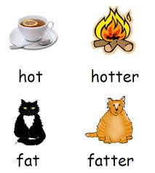
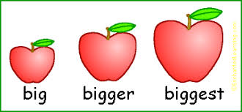
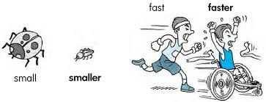
Comparative Adjectives
Damavand is
Asia is
Omid is
taller than
bigger than
younger than
Dena
Europe
Reza
Karoon is longer than Atrak
. Mars is smaller than Jupiter

Slide 10

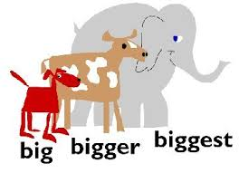
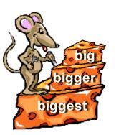
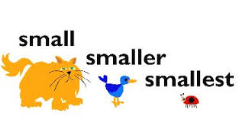
Superlative Adjectives
Damavand is
Asia is
Omid is
the tallest
the biggest
the youngest
mountain of Iran
of all.
student of our class
Karoon is the longest river of Iran.
Jupiter is the largest of all

