Slide 1
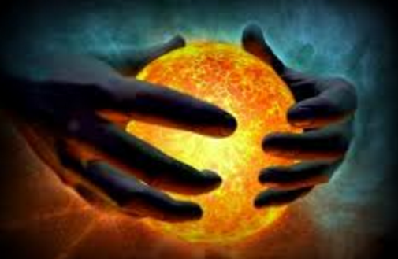
In The Name of Allah
Lesson 2
Wonders Of creation

Slide 2
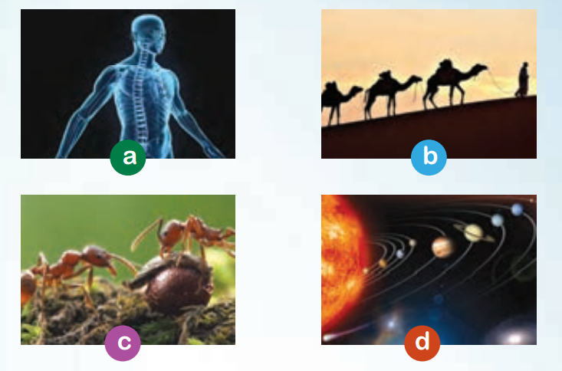
Are you ready ?!?
A : Our body is a wonderful
system.
B : Camels can live without
water for a long time.
C : Ants are amazing animals.
D : Planets go around the Sun

Slide 3
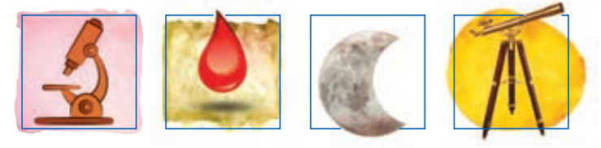
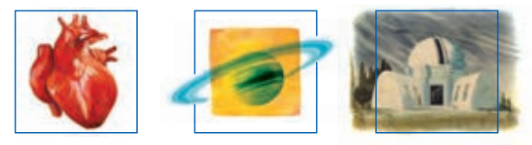
Match the pictures with the words.
Microscope blood moon telescope
heart ring observatory

Slide 4

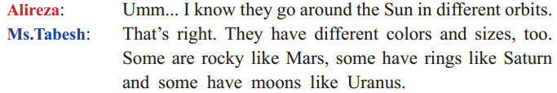
Conversation ----------

Slide 5
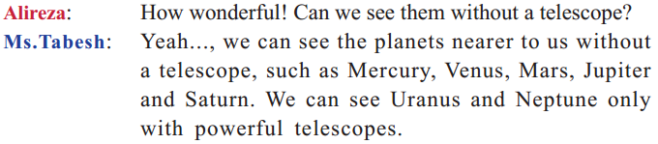
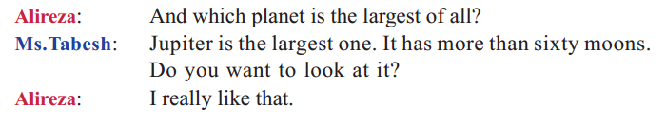
Discussion -------

Slide 6
Answer the following questions orally
1. How are the planets different?
2. Can we see all planets without a telescope?
3. Do you know the names of the planets in Persian?

Slide 7
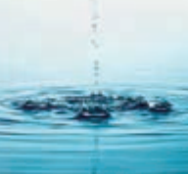
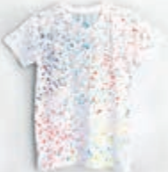
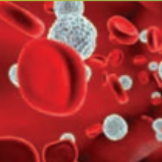

New words and New Expressions
Water is a type of liquid
There are some drops of paint on his shirt
Blood cells are red and white.
About one thousand
people live in this village.
easy to memorize these words with an example

Slide 8
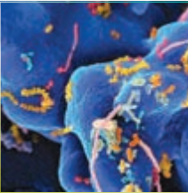

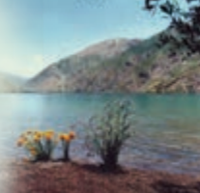
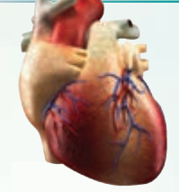
New words and New Expressions
There are many different
types of microbes
Doing daily exercise is
useful for everyone.
Gahar Lake is famous for its clear water.
The heart pumps blood round the body
easy to memorize these words with an example and a description

Slide 9

Read ! Practice ! Practice ! Practice !
healthy: 1 strong and well # He is a healthy boy.
2 good for your body # A healthy breakfast can give you more energy.
defend: to protect someone or something from danger
# The brave soldiers defended our country in war.
Carry : to move someone or something from one place to another
# Monkeys carry their babies all day long.
easy to memorize these words with an example and a description

Slide 10
Read ! Practice ! Practice ! Practice !
collect: to go and get someone or something
# The school bus collects the children each morning.
fact: things that are true or that really happened
# It’s a fact that Earth goes around the Sun.

Slide 11
Blood is a wonderful liquid
The human body is a real wonder. It is sometimes good to think about our body and how it works. Our body is doing millions of jobs all the time.
One of the most important parts of the body is blood. The heart
pumps this red liquid around the body. This keeps us healthy and alive.
More than half of blood is plasma. This is a clear and yellow liquid.
It carries red and white cells. There are millions of red blood cells
in one small drop of blood. They carry oxygen round the body and
collect carbon dioxide from body parts. There are thousands of white
cells in a drop of blood. They are bigger than red cells. They defend
our body against microbes.

Slide 12
Reading …
This wonderful liquid is a great gift from Allah. We can thank Allah
by keeping our body healthy. One way to do that is eating healthy food
and doing daily exercises. Another way is to donate our blood to those
who need it.
Read the above sentences carefully ! Find new words then find the meaning of theme .

Slide 13
CHOOS THE BEST ANSWER
1- What color is plasma?
a) red b) yellow c) white
2- How can we keep our body healthy?
a) By eating fast foods
b) By doing daily exercises
c) By sleeping late
3- How many white blood cells are there in a drop of blood?
a) hundreds b) thousands c) millions

Slide 14
TRUE ? !? FALSE Its seems the flag of iran ☺
T F
1. There are only white cells in plasma.
2. Red cells are smaller than white cells.
3. The number of red cells is more than white cells.

Slide 15
C. Match two halves.
C. Match two halves.
1. The heart pumps blood round the body …..
2. Our body is really wonderful ……
3. Red blood cells carry oxygen round the body …..
so it is sometimes good to think about it.
b. then it is dangerous.
c. and collect carbon dioxide.
d. to keeps us alive.

Slide 16
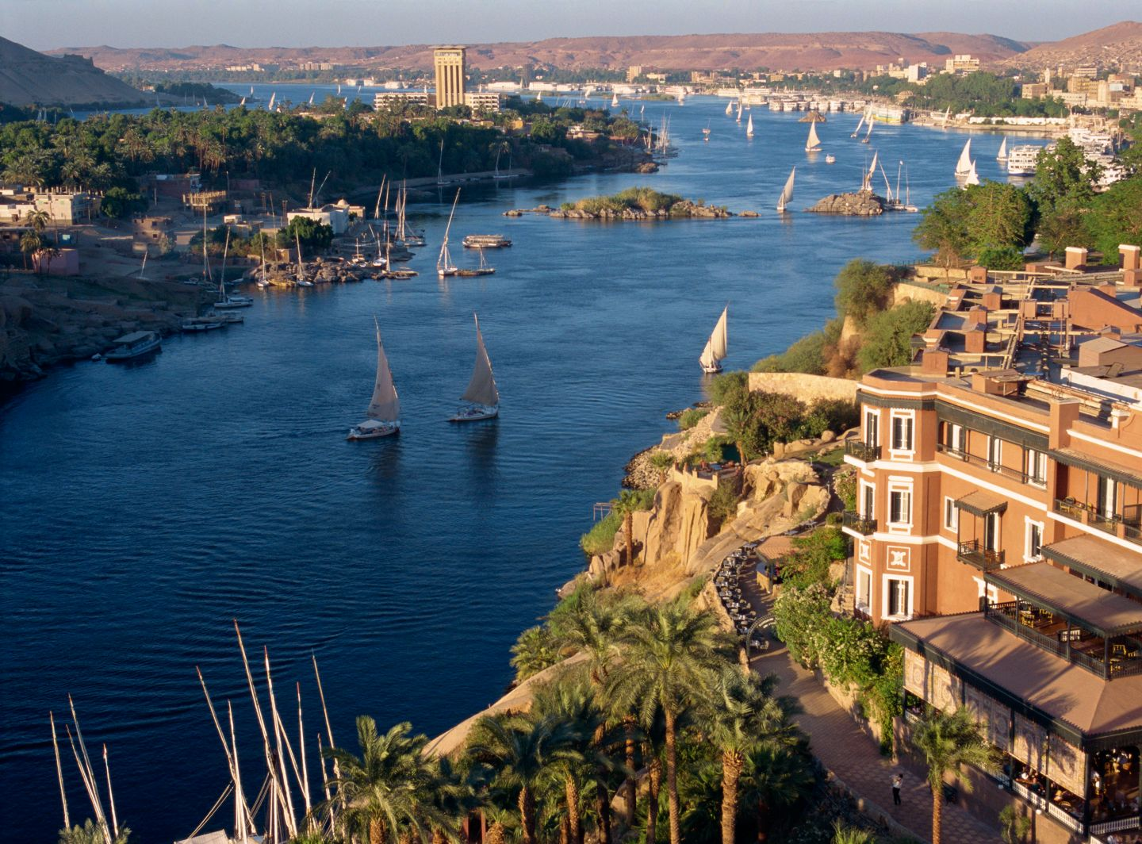
Grammar is the system of a language.
Read the following texts.
The Nile is the longest river on Earth. It is more than 6,000 kilometers. It is an important river for African people. It gives water to people and animals.
There are other rivers in Africa but they are not as important as the Nile. These rivers aren’t very long. They are useful for people of villages and small cities.
What a Beautiful creation !!!!

Slide 17

Read this too !
We live in a wonderful world. All around us there are amazing things like small and big animals; long
rivers; dark jungles; tall mountains; and different people and nations. This world is like a strange book.
We need to read it carefully. Then we can find many great things in our world.

Slide 18
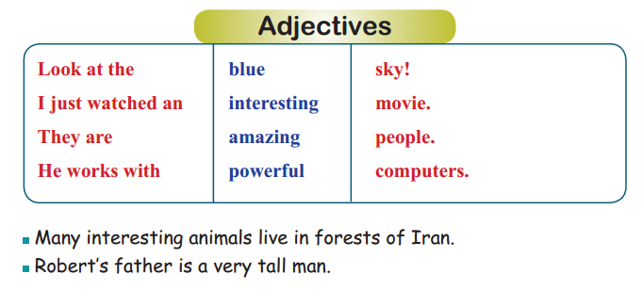
Read the following examples.

Slide 19
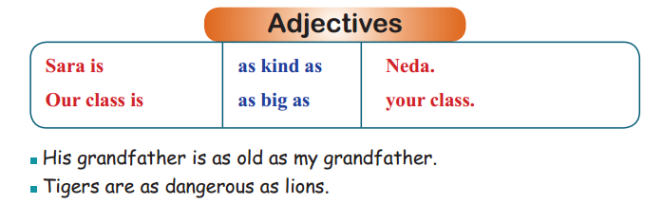
Read the following examples.

Slide 20
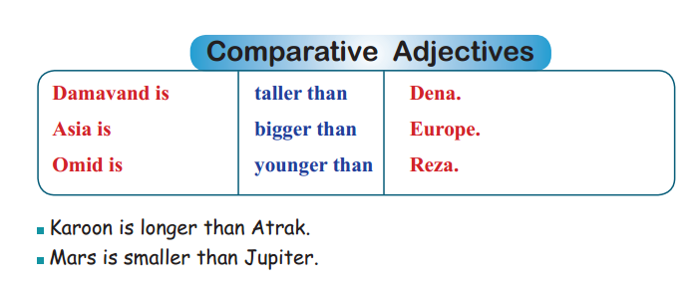

Slide 21
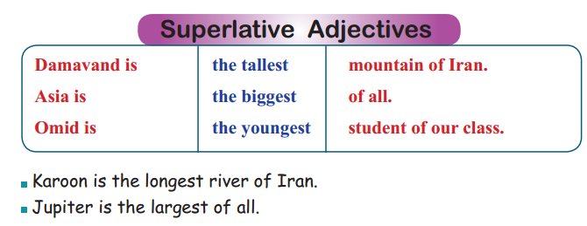
Read the following examples.

Slide 22
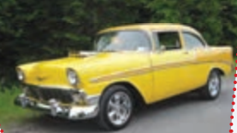
Look at the pictures and choose the best sentence.
This is a modern car O
This is an old car O

Slide 23
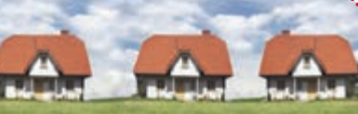
Look at the pictures and choose the best sentence.
Our house is the smallest of all. O
Our house is as small as their houses. O
Do you thinks these houses are small !?

Slide 24
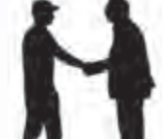
It is not different
David is taller than his father. O
David is as tall as his father . O

Slide 25
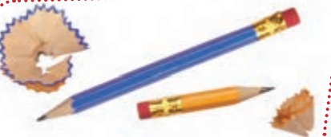
Its too
The blue pencil is longer than the yellow pencil.
The yellow pencil is as short as the blue pencil
The blue pencil is longer than the yellow pencil. O
The yellow pencil is as short as the blue pencil O

Slide 26
Work with a friend.
Make sentences with these adjectives to describe and compare people, things, or places you know.
1. brave
2. kind
3. large
4. fast

Slide 27

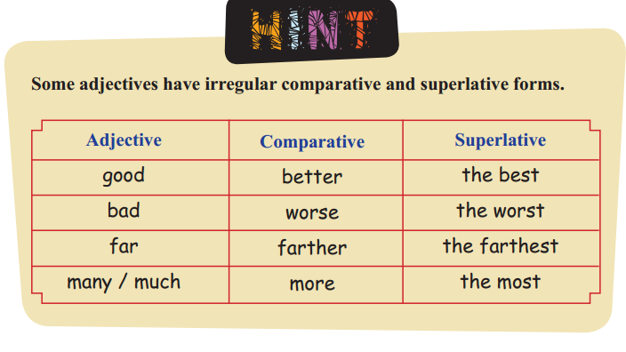
HINT

Slide 28
SEE ALSO
Read the following examples with ‘comparative/superlative adjectives’.
This problem is more difficult than that one.Actually, this is the most
difficult problem of the book.
Persian zebras are more beautiful than African zebras. They are the
most beautiful of all.

Slide 29
SEE ALSO
This laptop is more expensive than that one. It is the most expensive of all.
Sharks are more dangerous than whales. They are the most dangerous animals of the sea.

Slide 30
Gold !
Gold
Is expensive ! For rich people ! ☹
Is more expensive than Silver
Is the most expensive metal of the world.

Slide 31
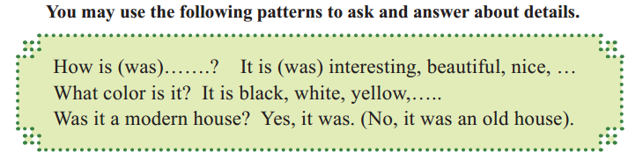
Listen ! Speak !
How was the movie? It was very interesting. I am going to watch it again.
Was it an old film? Yeah, actually it was black and white.

Slide 32
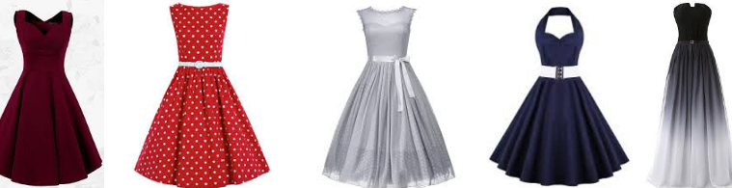
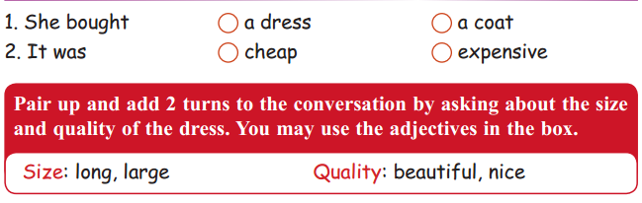
Listen to the following conversations and check the correct answer.

Slide 33
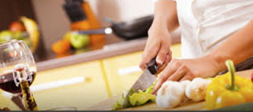
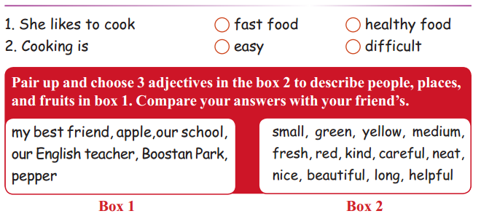
Listen to the following conversations and check the correct answer.

Slide 34
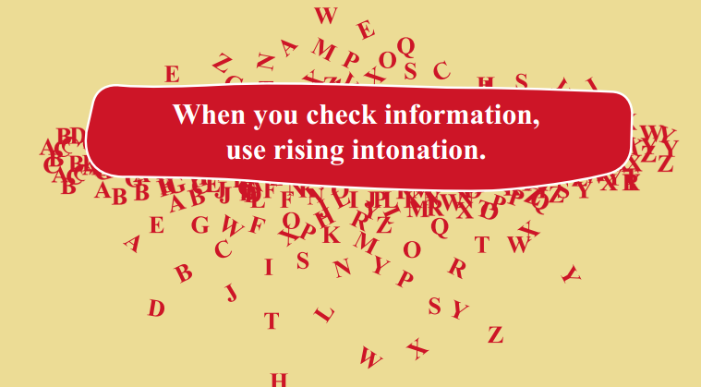
Rising intonations !
1. Is this your new car?
2. Was the book interesting?
3. Is this problem easier than that one?
4. Are they the most expensive houses in this city?

Slide 35
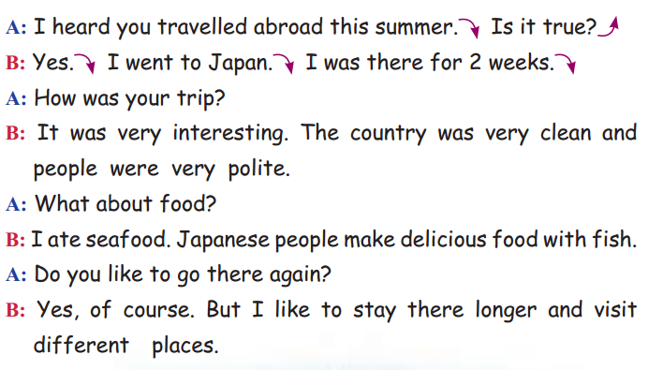
Listen again !

Slide 36
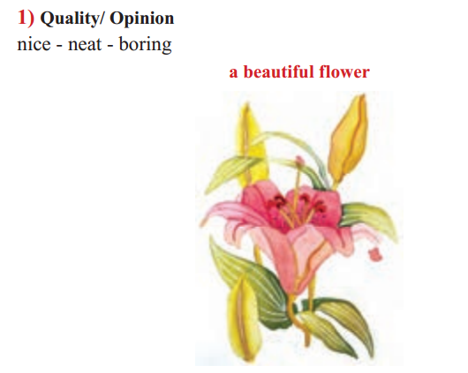
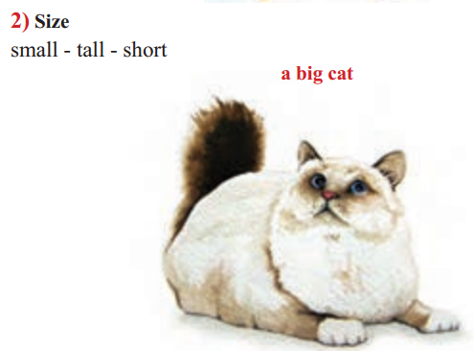
An adjective describes a noun. It gives more information in terms of such elements:
Writing

Slide 37
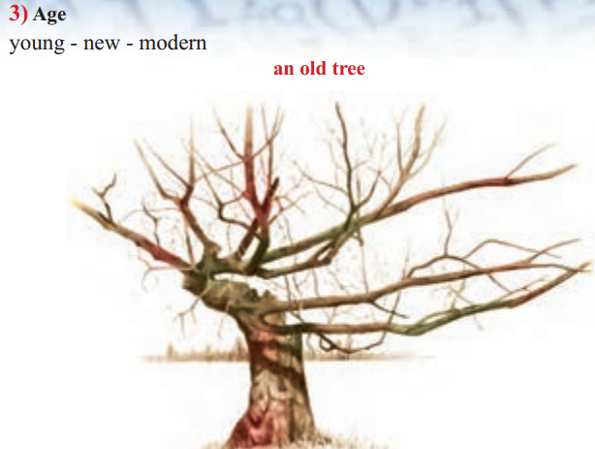
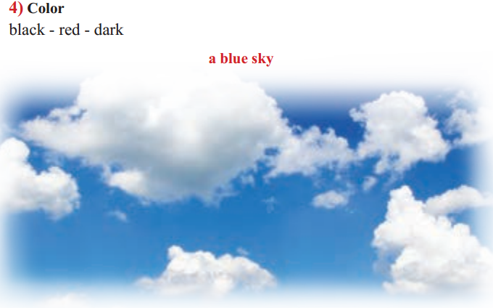

Slide 38
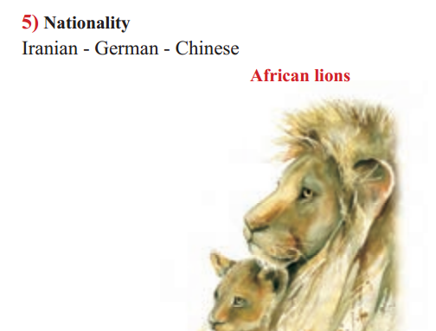
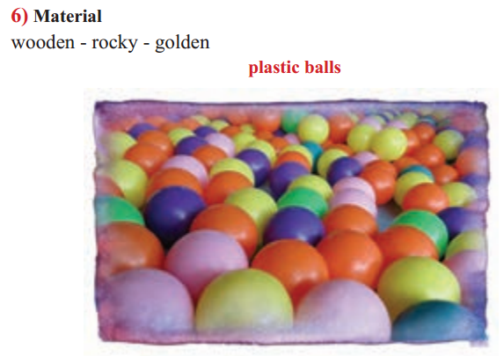

Slide 39
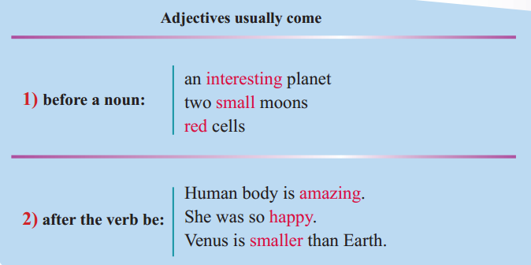
Place of Adjectives

Slide 40

Complete !
Complete each sentence with a suitable adjective. One adjective is extra.
Funny careful tall golden cloudy
1. It’s not ………….. Don’t laugh please!
2. She looked at the ………….. sky above the sea.
3. Be ………….. ! Look both ways when you cross the street.
4. Mary lost her ………….. watch in the park.

Slide 41
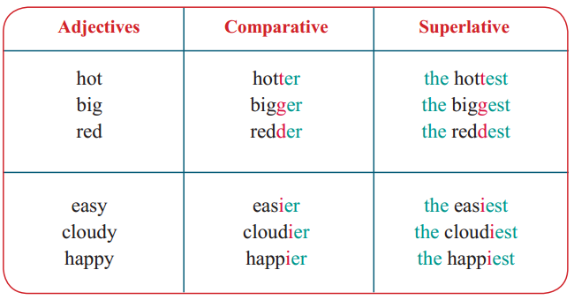
Spelling Hint
Look at the following adjective forms:

Slide 42
Write the comparative and superlative forms of each adjective.
1. angry
2. strong
3. hot
4. far
5. neat
6. ugly

Slide 43
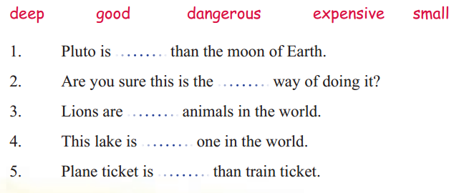
Complete each sentence with a comparative or superlative form of an adjective in the box.

Slide 44
BYE
Thank you

